Slide 1

Career Compass
22255A1202 N. Bhavya
21251A1230 T.S.Manasvini
21251A1209 C.Sowmya Reddy

Slide 2


PROBLEM STATEMENT
Students often struggle to find reliable and comprehensive information about career paths and the courses required to pursue them. Without access to this information, they may feel overwhelmed and uncertain about their future career prospects, which can lead to decision paralysis and lost opportunities. Our website aims to address this problem by providing students with up-to-date, relevant, and easy-to-navigate career information and course offerings, empowering them to make informed decisions and take proactive steps toward their future goals.

Slide 3


ABSTRACT
Most of the Indian Students are deprived from the exploration of various fields, courses and career opportunities and hence students end up in a scenario where they do not realize their true potentials. Our website CAREER COMPASS provides to-the-point information about all the available streams and career opportunities to a student in India. The website will help in organizing the data related to the available courses-its brief description, its eligibility criteria, entrances (if required) etc. A student can easily browse through the website and depending on their interests/inclination towards a particular field they can get a brief idea of the available options and hence prepare for the same. This website would save the time and access of information would be very simplified. Hence the user is relieved from the burden of surfing through the net to get the authentic information.

Slide 4

INTRODUCTION
Our website Career Compass is dedicated to providing valuable career information and courses for students!
This website provide comprehensive information about various career options, as well as the courses you can take to help you achieve your career learning about different career fields, exploring courses to enhance your skills and knowledge, or seeking guidance on how to navigate the job market, we're here to help.
Our website is designed to provide you with everything you need to make informed decisions about your future.

Slide 5
SCOPE OF THE PROJECT
Career exploration:
The website provides information on various careers and industries
Job duties for different roles are outlined
Required skills and education for each career path are listed
Salary ranges for different positions are included
Growth prospects for different industries are discussed
Industry trends and news:
The website provides industry news and trends
Students can stay updated on new job opportunities within their chosen field
Emerging industries are highlighted and discussed
Changes in the labour market are covered.
Success stories and testimonials:
The website showcases success stories and testimonials from people in different fields. Students can be inspired and motivated by these stories
Examples of different paths to success are provided
The scope of the project will depend on the goals of the website and the needs of the target audience
Conducting research may be necessary to gather information for the website

Slide 6
EXISTING SYSTEM
An existing system for a career website may provide basic information on careers and industries.
It may feature text-based articles with some graphics or images.
However, it may not be user-friendly or engaging enough for students.
It may lack interactive tools to help students explore career options and match their strengths and interests with suitable job roles.
The website may not provide enough up-to-date information on industry trends and news.
Limited user engagement may be a challenge for a text-based website with only basic information.

Slide 7
PROPOSED SYSTEM
A proposed system for a career website would be more comprehensive and user-friendly.
It would provide a range of features and tools to help students explore different career paths and make informed decisions about their future.
The proposed system could include interactive tools such as salary scale which help students to match them with suitable career options
Industry professionals can share their experiences which can really help students to take the right path and know about that profession.
This type of system would be more engaging, user-friendly, and informative than the existing system

Slide 8

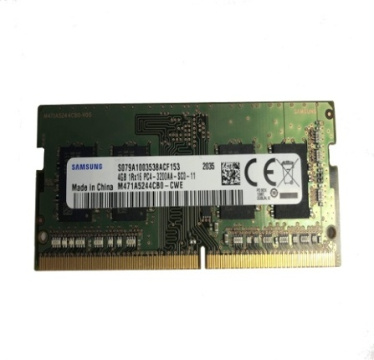
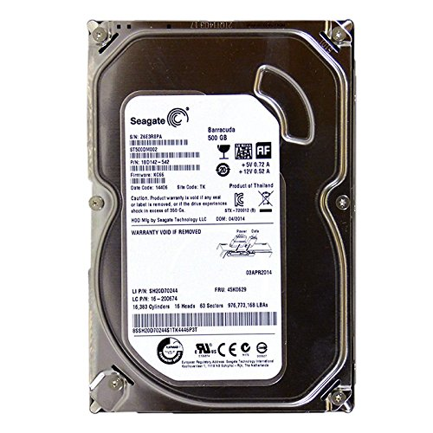
SOFTWARE&HARDWARE requirements
Hardware
Intel Core i5
4GBRAM
500GB HDD

Slide 9




Software
HTML
CSS
PHP
MySQL

Slide 10
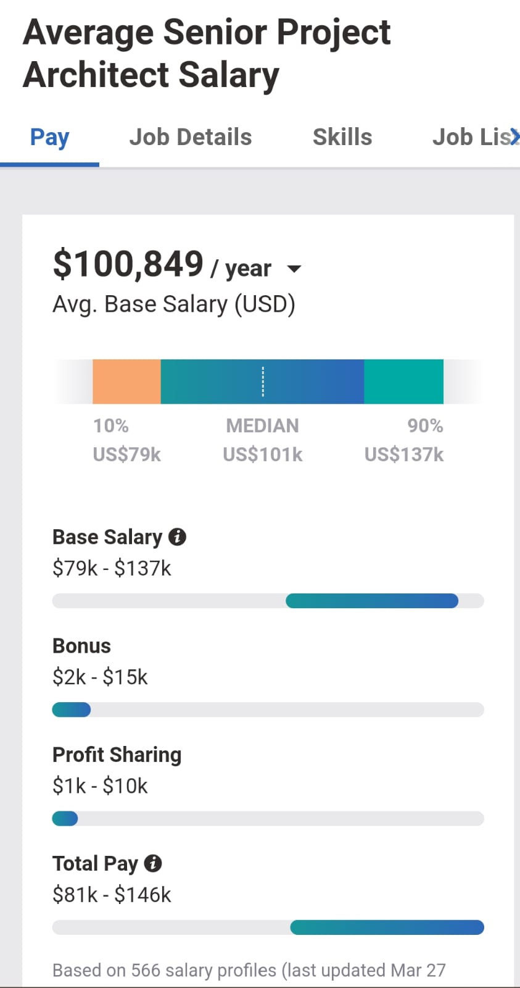
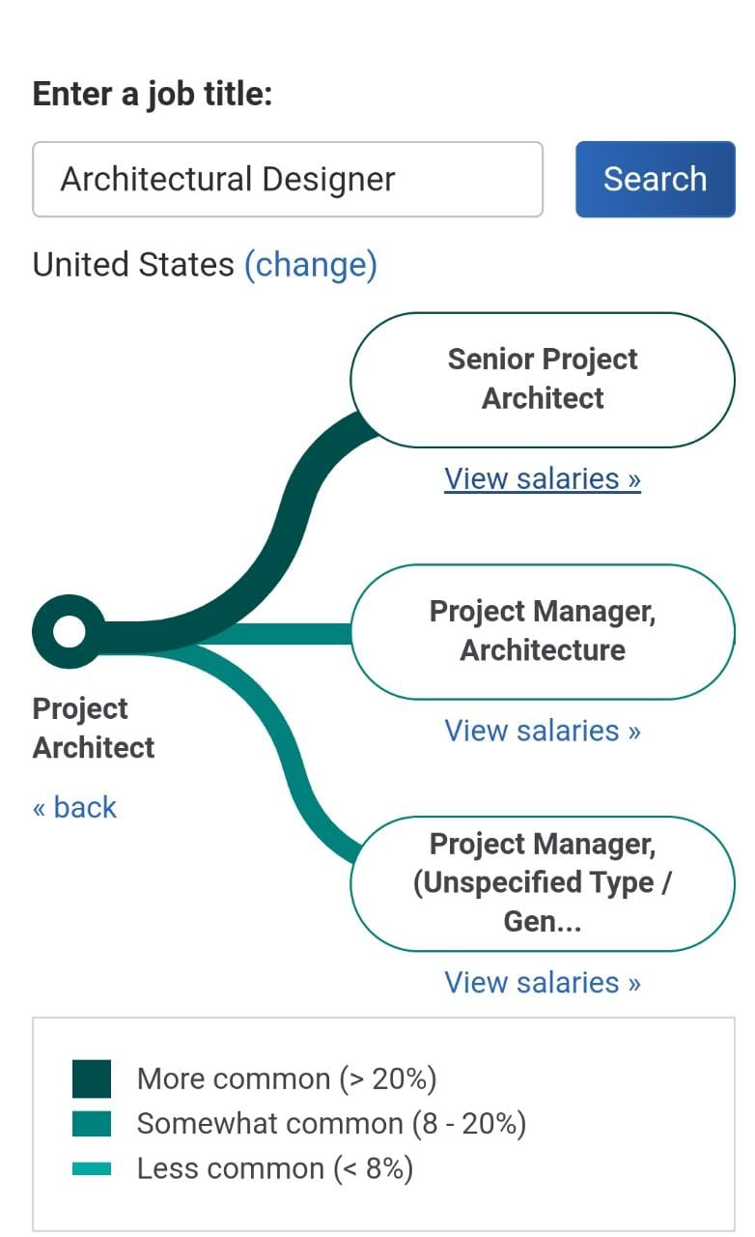
UI DESIGNS

Slide 11
THANK YOU!!

